Slide 1
State-action model

Slide 2
Inspiration from NHL work
Context: score and manpower differential, period
Actions: 13 action types and their location
Action locations are clustered to reduce dimensionality

Slide 3
Context candidates
Score differential in current set:
potentially from -25 to +25, but probably only interesting in a narrower band
Current higher score in set
Up to 25 and beyond, again could be reduced
Set number?
1 to 5
Maybe current team rotations?
1 to 6 for each team, maybe just setter front/back row?
+4 to -4 for score differential and 3 values for current higher score (0-10, 11-20, 21-...) would give 27 context combinations

Slide 4
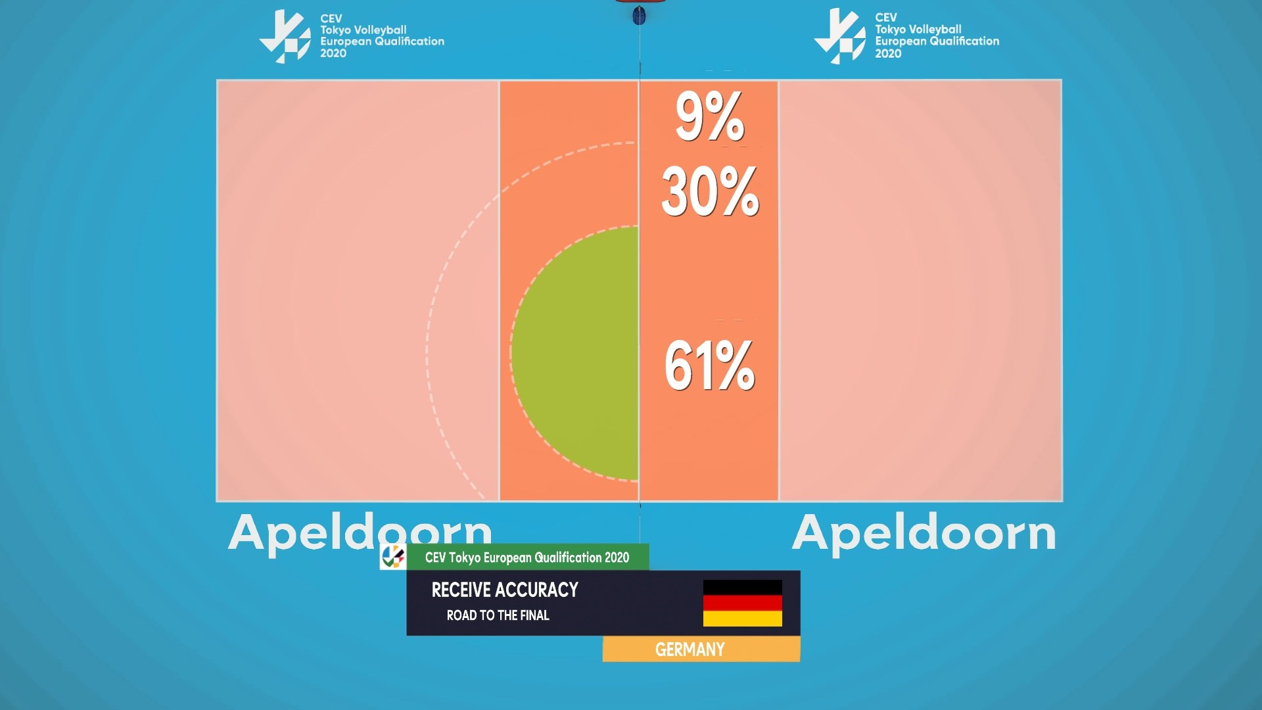
Actions
7 Action types
Serve, receive, set, attack, block, dig, free ball
Outcomes, especially non-terminating ones, are important – e.g. we want to know the value of R# vs R+
Receive in particular: separate S and R actions by where the ball ended up after receive (something like 8 zones could make sense)
Attack: separate by location of attacker (left, right, middle, back-row right, back-row middle, other) and outcome (6 outcomes)
What else?
Serve type: spin or float
Attack type: high or fast
Receive type: hands or forearms
Looking at S 16, R 8, A 54, E 3, B 5, D 3 = 89 actions
Context-action pairs: 27x89 = 2403 (25,704 in NHL)

Slide 5
Rewards
Episodes are very natural: each rally is an episode
Won rally: +1
Lost rally: 0
Do we care about winning sets and games? NHL work didn’t give extra reward for winning the game in the end.

